Slide 1

Minda Corporation Ltd.
Die Casting Division
Bhamboli, Pune. Plant - II
As cast Test Bar For Tensile Testing

Slide 2
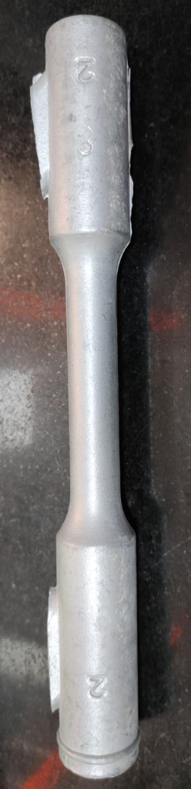
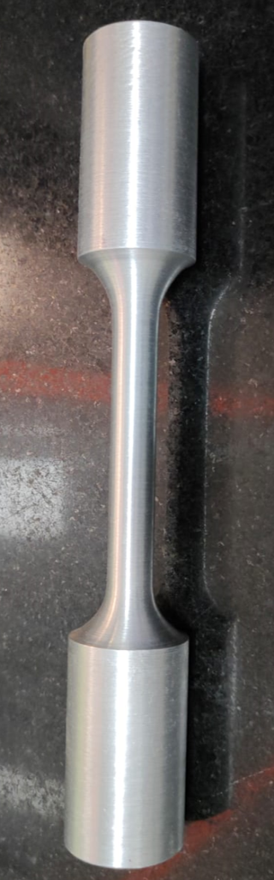
1.Existing Process of Tensile Testing:-
Preparation Of Test Bar
Required Machining For Testing
Current Status
1.As per Existing Process required 100% machining for tensile testing.
2.Monthly near about 80 No's test bar required for tensile testing.
3.Cost of 80 no's test bar for machining is Rs-20000/- Per Month.
4.Minimum one hour required for first test bar pouring.
5.Considering time consuming and cost we have to design as cast test bar for tensile testing.

Slide 3
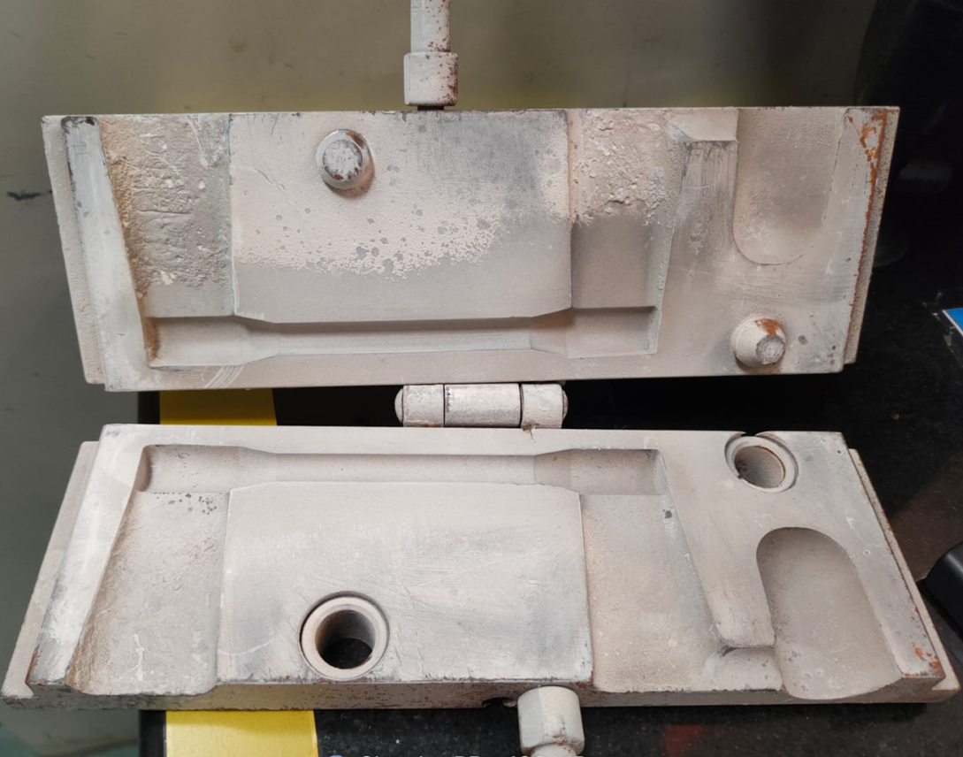
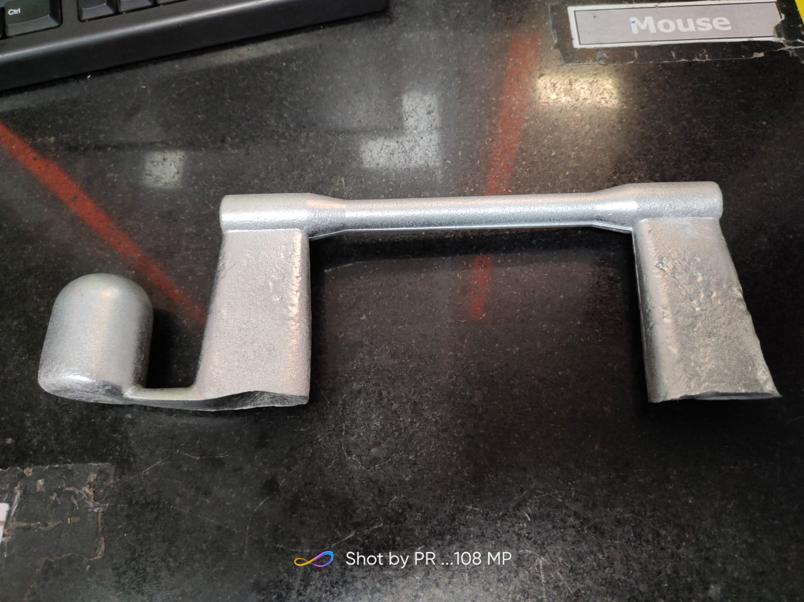
2.Design Of Mould for Making Test Bat:-
Mould Design
Outcome From Mould
Actual Tensile test Piece

Slide 4
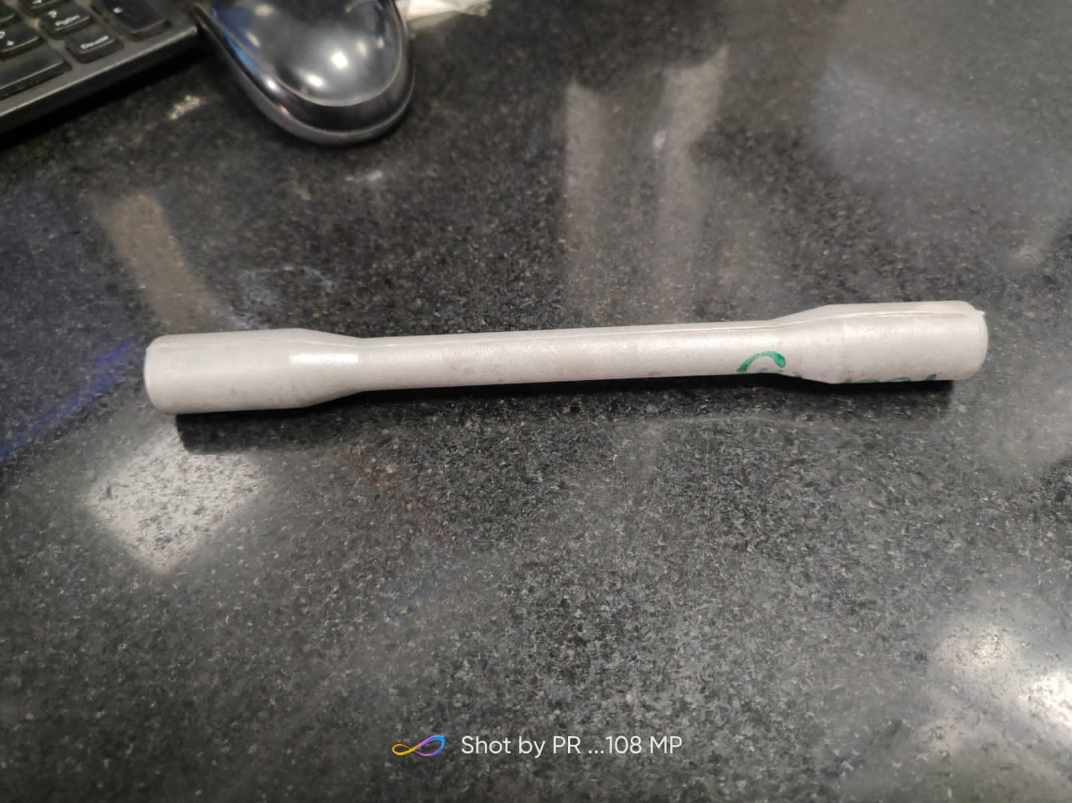
Actual Test bar for Tensile testing:-
Tensile Test Specimen
Benefits
1.No need to do any machining.
2.Very less time within 20 Minutes we can start for making test bar.
5.Near about Rs 20000/-Per month saving achieved.
Foundry –GDC, LPDC

Slide 5


